Slide 1
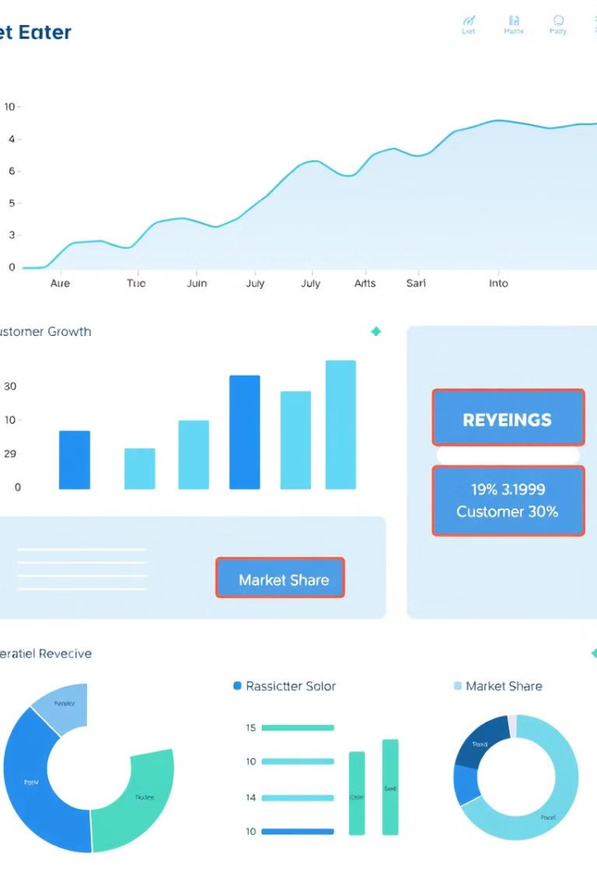

Transaction Analysis: March 2024
Analysis of transaction data from March 2024. The dataset includes transaction counts between states. Key findings include top states by transaction volume. The analysis also identifies transaction outliers.
by Bharath Reddy

Slide 2

Data Overview
Entries
Home States
The dataset contains 323 entries.
There are 23 unique home states.
Sale States
There are 28 unique sale states.

Slide 3
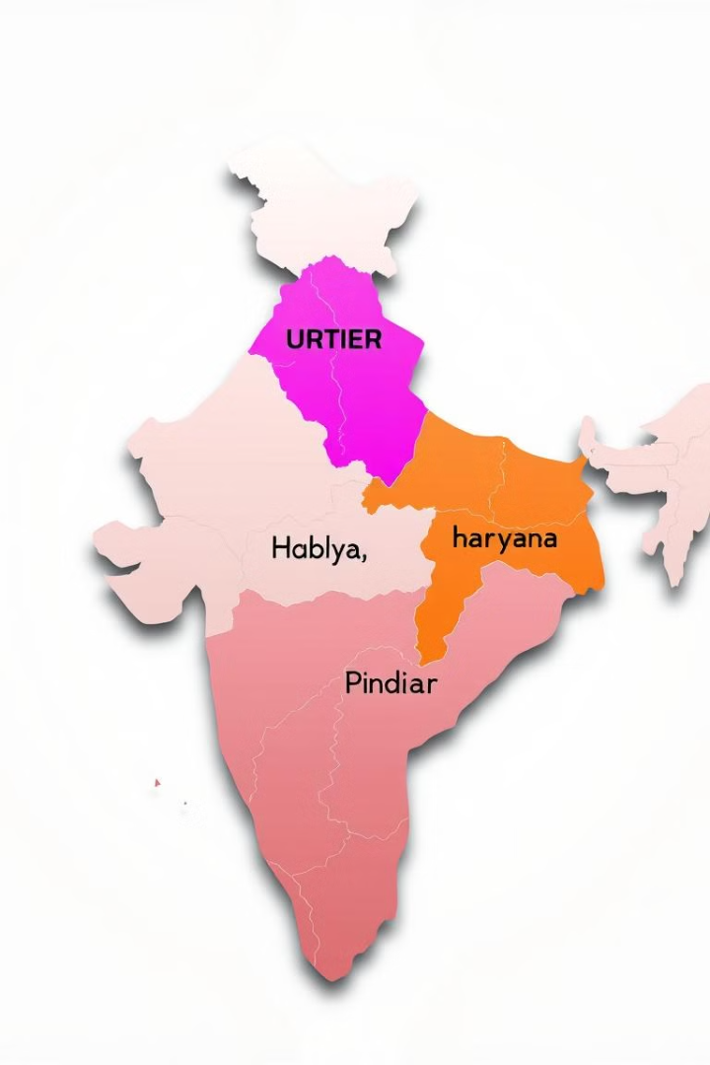
Top 5 States by Transaction Count
1
Uttar Pradesh
264,087 transactions
2
Bihar
245,021 transactions
3
Madhya Pradesh
29,792 transactions
4
Haryana
10,557 transactions

Slide 4
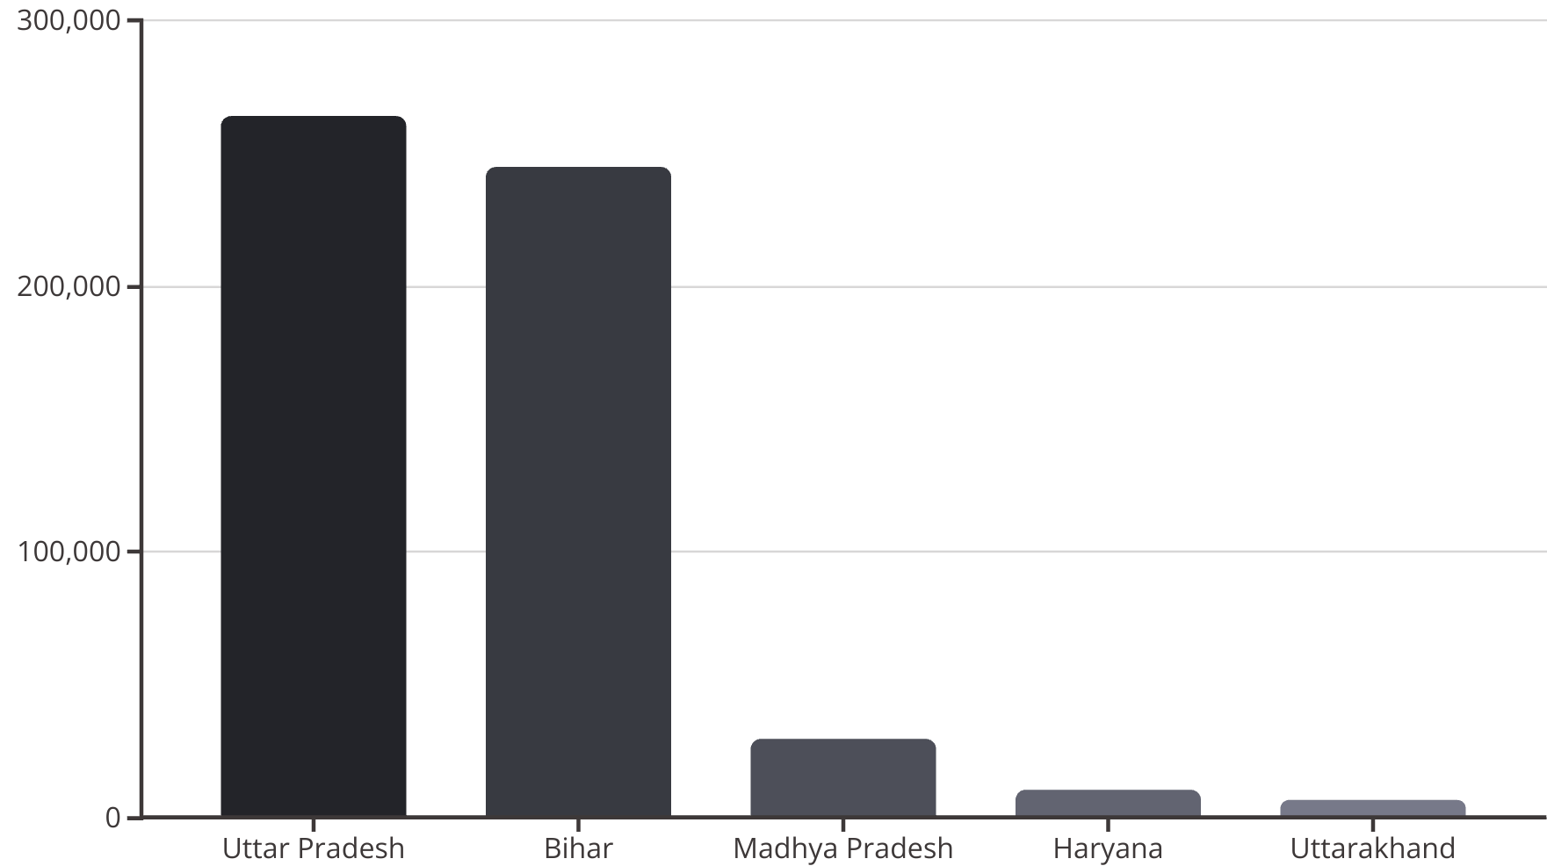
Transactions by Home State
Transactions grouped by home state. Uttar Pradesh and Bihar lead. Madhya Pradesh, Haryana, and Uttarakhand follow.

Slide 5
Top 5 Home-Sale State Pairs
Bihar to Delhi
Uttar Pradesh to Delhi
Uttar Pradesh to Maharashtra
Uttar Pradesh to Haryana
178,586 transactions
169,401 transactions
29,935 transactions
28,945 transactions

Slide 6

Transaction Distribution by Month
The dataset contains transaction data for March 2024. All transactions occurred in March.
March
All transactions occurred in March 2024.

Slide 7




Percentage of Transactions Per Home State
Uttar Pradesh
45.55%
Bihar
42.26%
Madhya Pradesh
5.14%

Slide 8
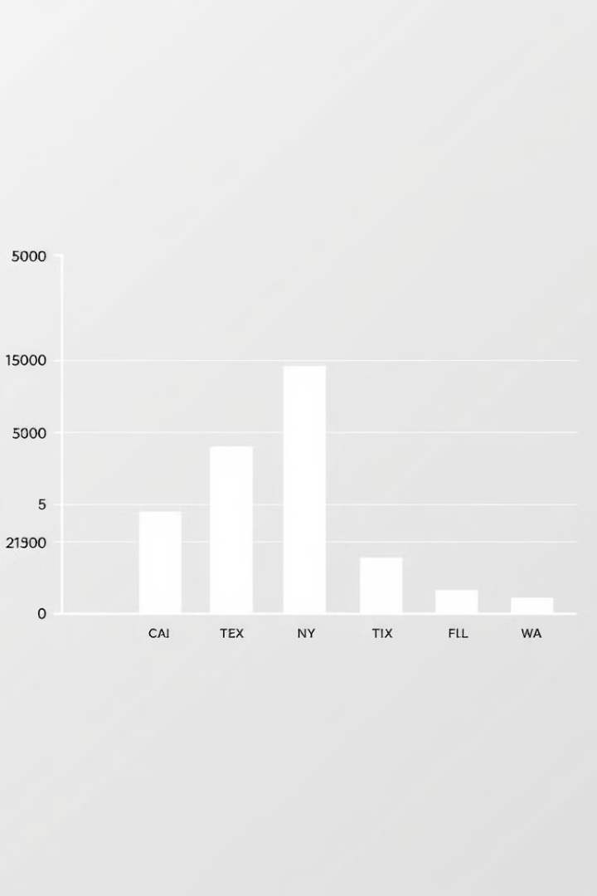
Median Transactions Per Home State
Bihar
Uttar Pradesh
Median: 759
Median: 466
Madhya Pradesh
Median: 140

Slide 9
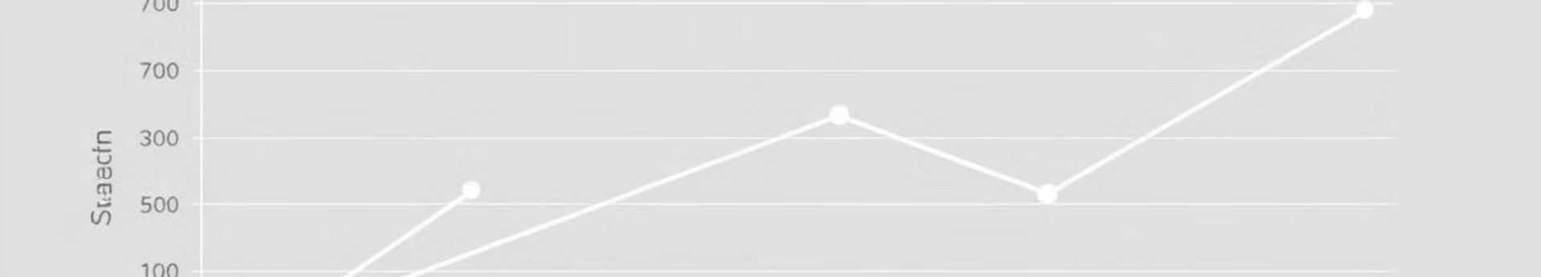



States with Consistent Transactions
Tripura
Telangana
Nagaland
Tripura, Telangana and Nagaland show low variance. This indicates consistent transaction volumes.

Slide 10
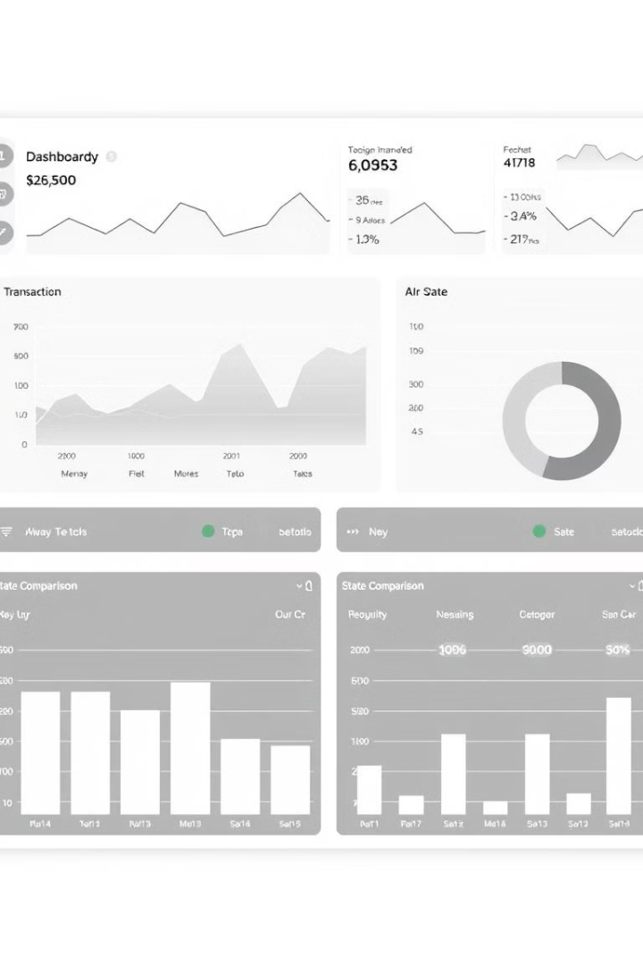
Key Takeaways
Uttar Pradesh & Bihar
Delhi
A key sale state for many home states.
Dominate transaction volumes.
Consistent States
Tripura, Telangana, Nagaland show stable activity.

